Slide 1

Xianhua Zeng is a senior SAS programmer at PRAEXEL with 5+
years of experience in clinical trials industry
PharmaSUG 2018
Paper #QT-08

Slide 2

Xianhua Zeng, PAREXEL, Shanghai, China
PharmaSUG 2018
Paper #QT-08

Slide 3

Introduction
Methodology
Macro Invoke
Output
References
Summary

Slide 4

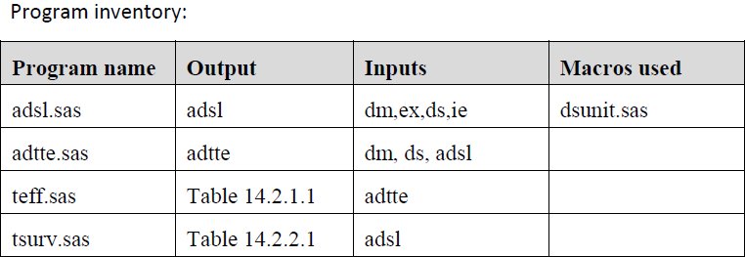
When writing ADRG, the program inventory needs to be created in section ‘Submission of Programs’
Manually or programmatically?
Macro %extdsnman can accomplish this task efficiently

Slide 5

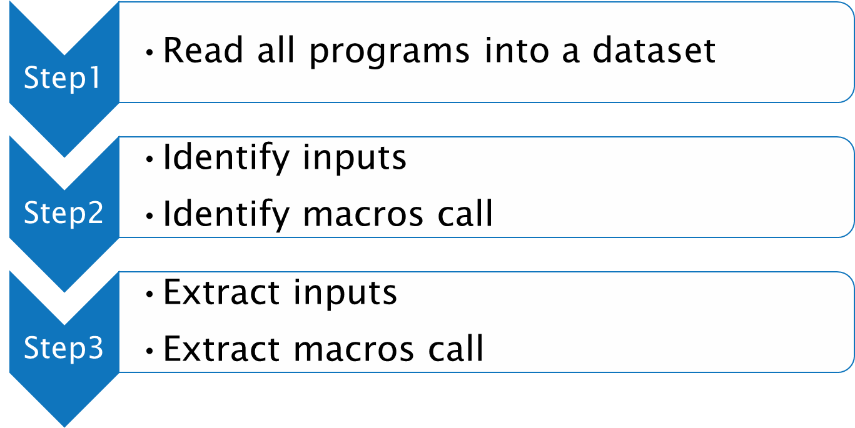

Slide 6
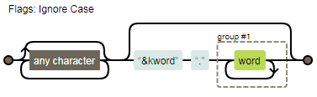
Source code example
  Extract inputs
  RE=prxparse("s/.*?(?:(?:&kword)\.(\w+))?/\1 /i");
  Regular expression visualization by Regexper

Slide 7

%extdsnman(p_path = /demo_path/prog/
, m_path = /demo_path/macros/
, kword = analysis|raw
, o_path = /demo_path/);
Parameter | Description
P_PATH | Path to the parent directory where all SAS programs are located
M_PATH | Path to the directory where macros are located
KWORD | Library name of analysis or SDTM datasets
O_PATH | Path to the output directory where program inventory is located

Slide 8

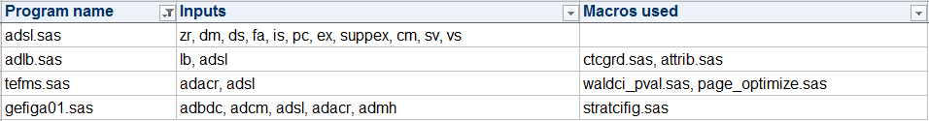

Slide 9

PhUSE CSS Working Group. “Analysis Data Reviewer’s Guide (ADRG), v1.1”. Available at http://www.phusewiki.org/wiki/images/d/df/ADRG_v1.1_2015-01-26.zip
Jeff Avallone. “Regexper”. Available at http://www.regexper.com/.

Slide 10

Perl regular expression (PRX) functions
FOPEN/FREAD/FGET functions
Useful tool which can greatly improve the efficiency of creating program inventory for ADRG.

Slide 11
Thanks!
Any questions?

Slide 12
Name: Xianhua Zeng
Organization: PAREXEL International
Address: Unit A/B/C 10F, No.506, Shangcheng Road,
Pudong District, Shanghai, China
City, State ZIP: 200120
Work Phone: +86 21-51118305
Fax: +86 21 61609196
E-mail: Allen.Zeng@PAREXLE.com
Web: http://www.parexel.com/
http://www.xianhuazeng.com/
Twitter: @XianhuaZeng

